Slide 1

https://github.com/pyladiesams/kedro-prod-ready-ds-pipelines-aug2025

Slide 2



Data science that ships: production-ready pipelines with Kedro
Merel Theisen for PyLadies Amsterdam
26th of August 2025
Notes:
Embedding Software Engineering Best Practices into Machine Learning Projects with Kedro

Slide 3
Agenda
About me
Common challenges for data practitioners
Intro to Kedro
Modularity
Separation of concerns
Maintainability
Q&A

Slide 4

About me
Pronouns: she/her ⭐️
I’m from the Netherlands 🇳🇱
I’ve been working as a Software Engineer for 9 years 👩🏼‍💻
Currently Principal Software Engineer at QuantumBlack ✨
I’ve been the tech lead for Kedro for over 3 years 🚀
Contact
merel.theisen@quantumblack.com

Slide 5
01
Common challenges for data practitioners

Slide 6
Under-engineering refers to building with reduced complexity resulting in a less robust, efficient and capable product. It happens because of tight deadlines or because of a lack of expertise.
We under-engineer data science experiments & create code with a lot of technical debt
Technical debt is intentional or accidental decisions that make code difficult to understand, maintain, extend and fix. Much like a loan, you pay a higher cost later, because it decreases the team's agility as the project matures.

Slide 7


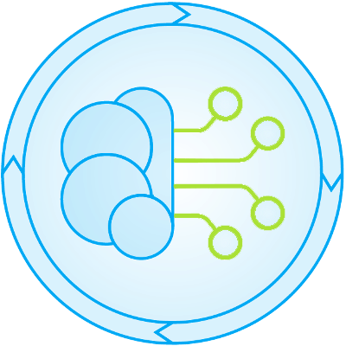
How do we usually pay off this technical debt?
​Data scientists handover code to data & machine-learning engineers
“Part of the context is that I may fall slightly on the less technical side, so I have been mainly working out of notebooks and relying on data engineers to productionalise code.”
RESEARCH PRODUCTION
Data Scientists
Data & ML Engineers
DATA SCIENTIST AT A MAJOR PHARMACEUTICAL COMPANY
Anyone that gets to create data science experiments in the research phase
Anyone that must overhaul data science experiments produced in the research phase

Slide 8

“Data scientists have to learn so many tools to create high-quality code.”
“I have to think about Sphinx, flake8, isort, black, Cookiecutter Data Science, Docker, Python Logging, virtual environments, Pytest, configuration and more .”
“I spend a lot of time trying to understand a codebase that I didn’t write.”
The challenges of creating machine learning products
“It’s tedious to always setup documentation and code quality tooling my project.”
“Everyone works in different ways.”
A workflow beyond notebooks still has challenges
“It takes really long to put code in production and we have to rewrite and restructure large parts of it.”
“My code will not run on another person’s machine.”
“No one wants to use the framework I created.”
“We all have different levels of exposure to software engineering best-practice.”
7
Notes:
Lack of standardized coding practices
Difficulty in sharing code across different environments

Slide 9
“It’s an approach or process that’s understood to help build software that’s superior in terms of speed of execution, shipping with higher quality, or building more maintainable code.”
GERGELY OROSZ,
AUTHOR OF THE PRAGMATIC ENGINEER

Slide 10
02
Intro to Kedro

Slide 11



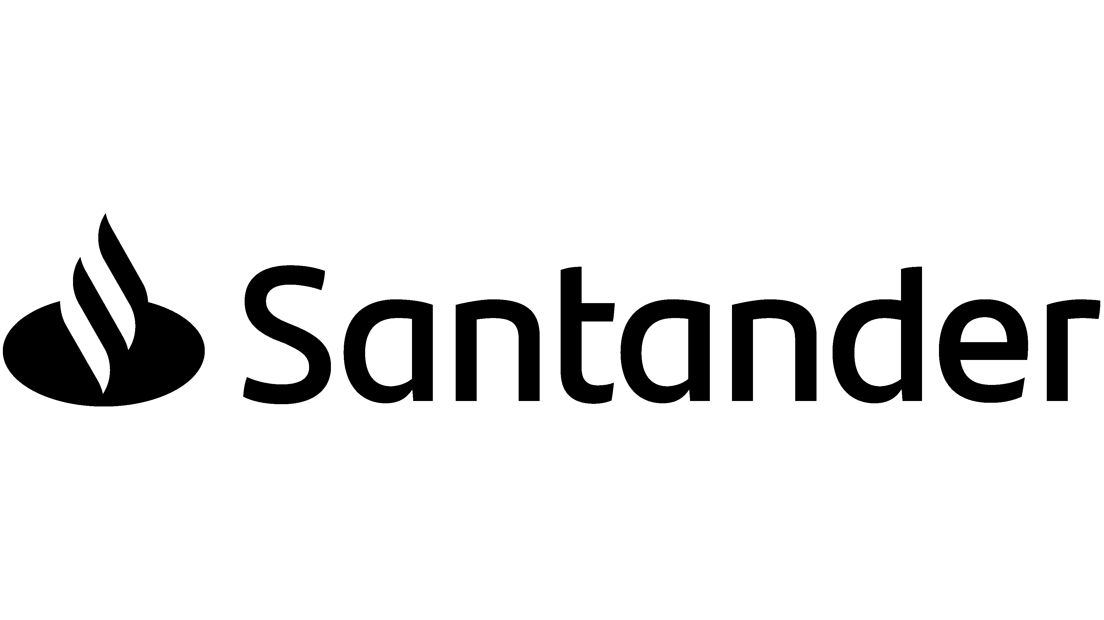












Benefits
Enterprise adoption
Reduces the time spent rewriting data science experiments so that they are fit for production. Encourage harmonious team collaboration and improve productivity. Upskills all collaborators on how to apply software engineering principles to data science code.
Kedro
An open-source Python toolbox that applies software engineering principles to data science code, making it easier to transition from prototype to production.
+10,000 GITHUB STARS
FOUNDED IN
+500,000 MONTHLY DOWNLOADS
2017
Developed by
STATUS
+29,000,000 PIPELINE RUNS IN 2023
Notes:
- Initially built within QuantumBlack & McKinsey for internal use
2019 OS + Linux Foundation 2022
- Open-source Python framework created for ML & data practitioners
- Bringing software engineering best practices to data projects: encouraging Modularity, Separation of concerns and Versioning
- Expanded collaborations beyond QB McKinsey

Slide 12
We built Kedro to reduce technical debt in data science experiments, making an easier transition from experimentation to production
Notes:
- Addresses shortcomings of Jupyter notebooks with a focus on maintainable data science code
You can think of Kedro as “React” or “Django” for ML projects

Slide 13










What does Kedro give you?
Project Template
Data Catalog
Nodes + Pipelines
Run status visualisation
Extensibility
Inspired by Cookiecutter Data Science
Our core declarative IO abstraction layer
Constructs which enable data-centric workflows
Constructs to facilitate debugging
Inherit, hook in or plug-in to make Kedro work for you
Ingest Raw Data
Clean & Join Data
Engineer Features
Train & Validate Model
Deploy Model
ZONE OF INFLUENCE
Notes:
CONSITENCY
Template: consistency in project structure
Catalog: consistency of reading/writing data

Slide 14
03
The workshop project

Slide 15
https://github.com/pyladiesams/kedro-prod-ready-ds-pipelines-aug2025

Slide 16
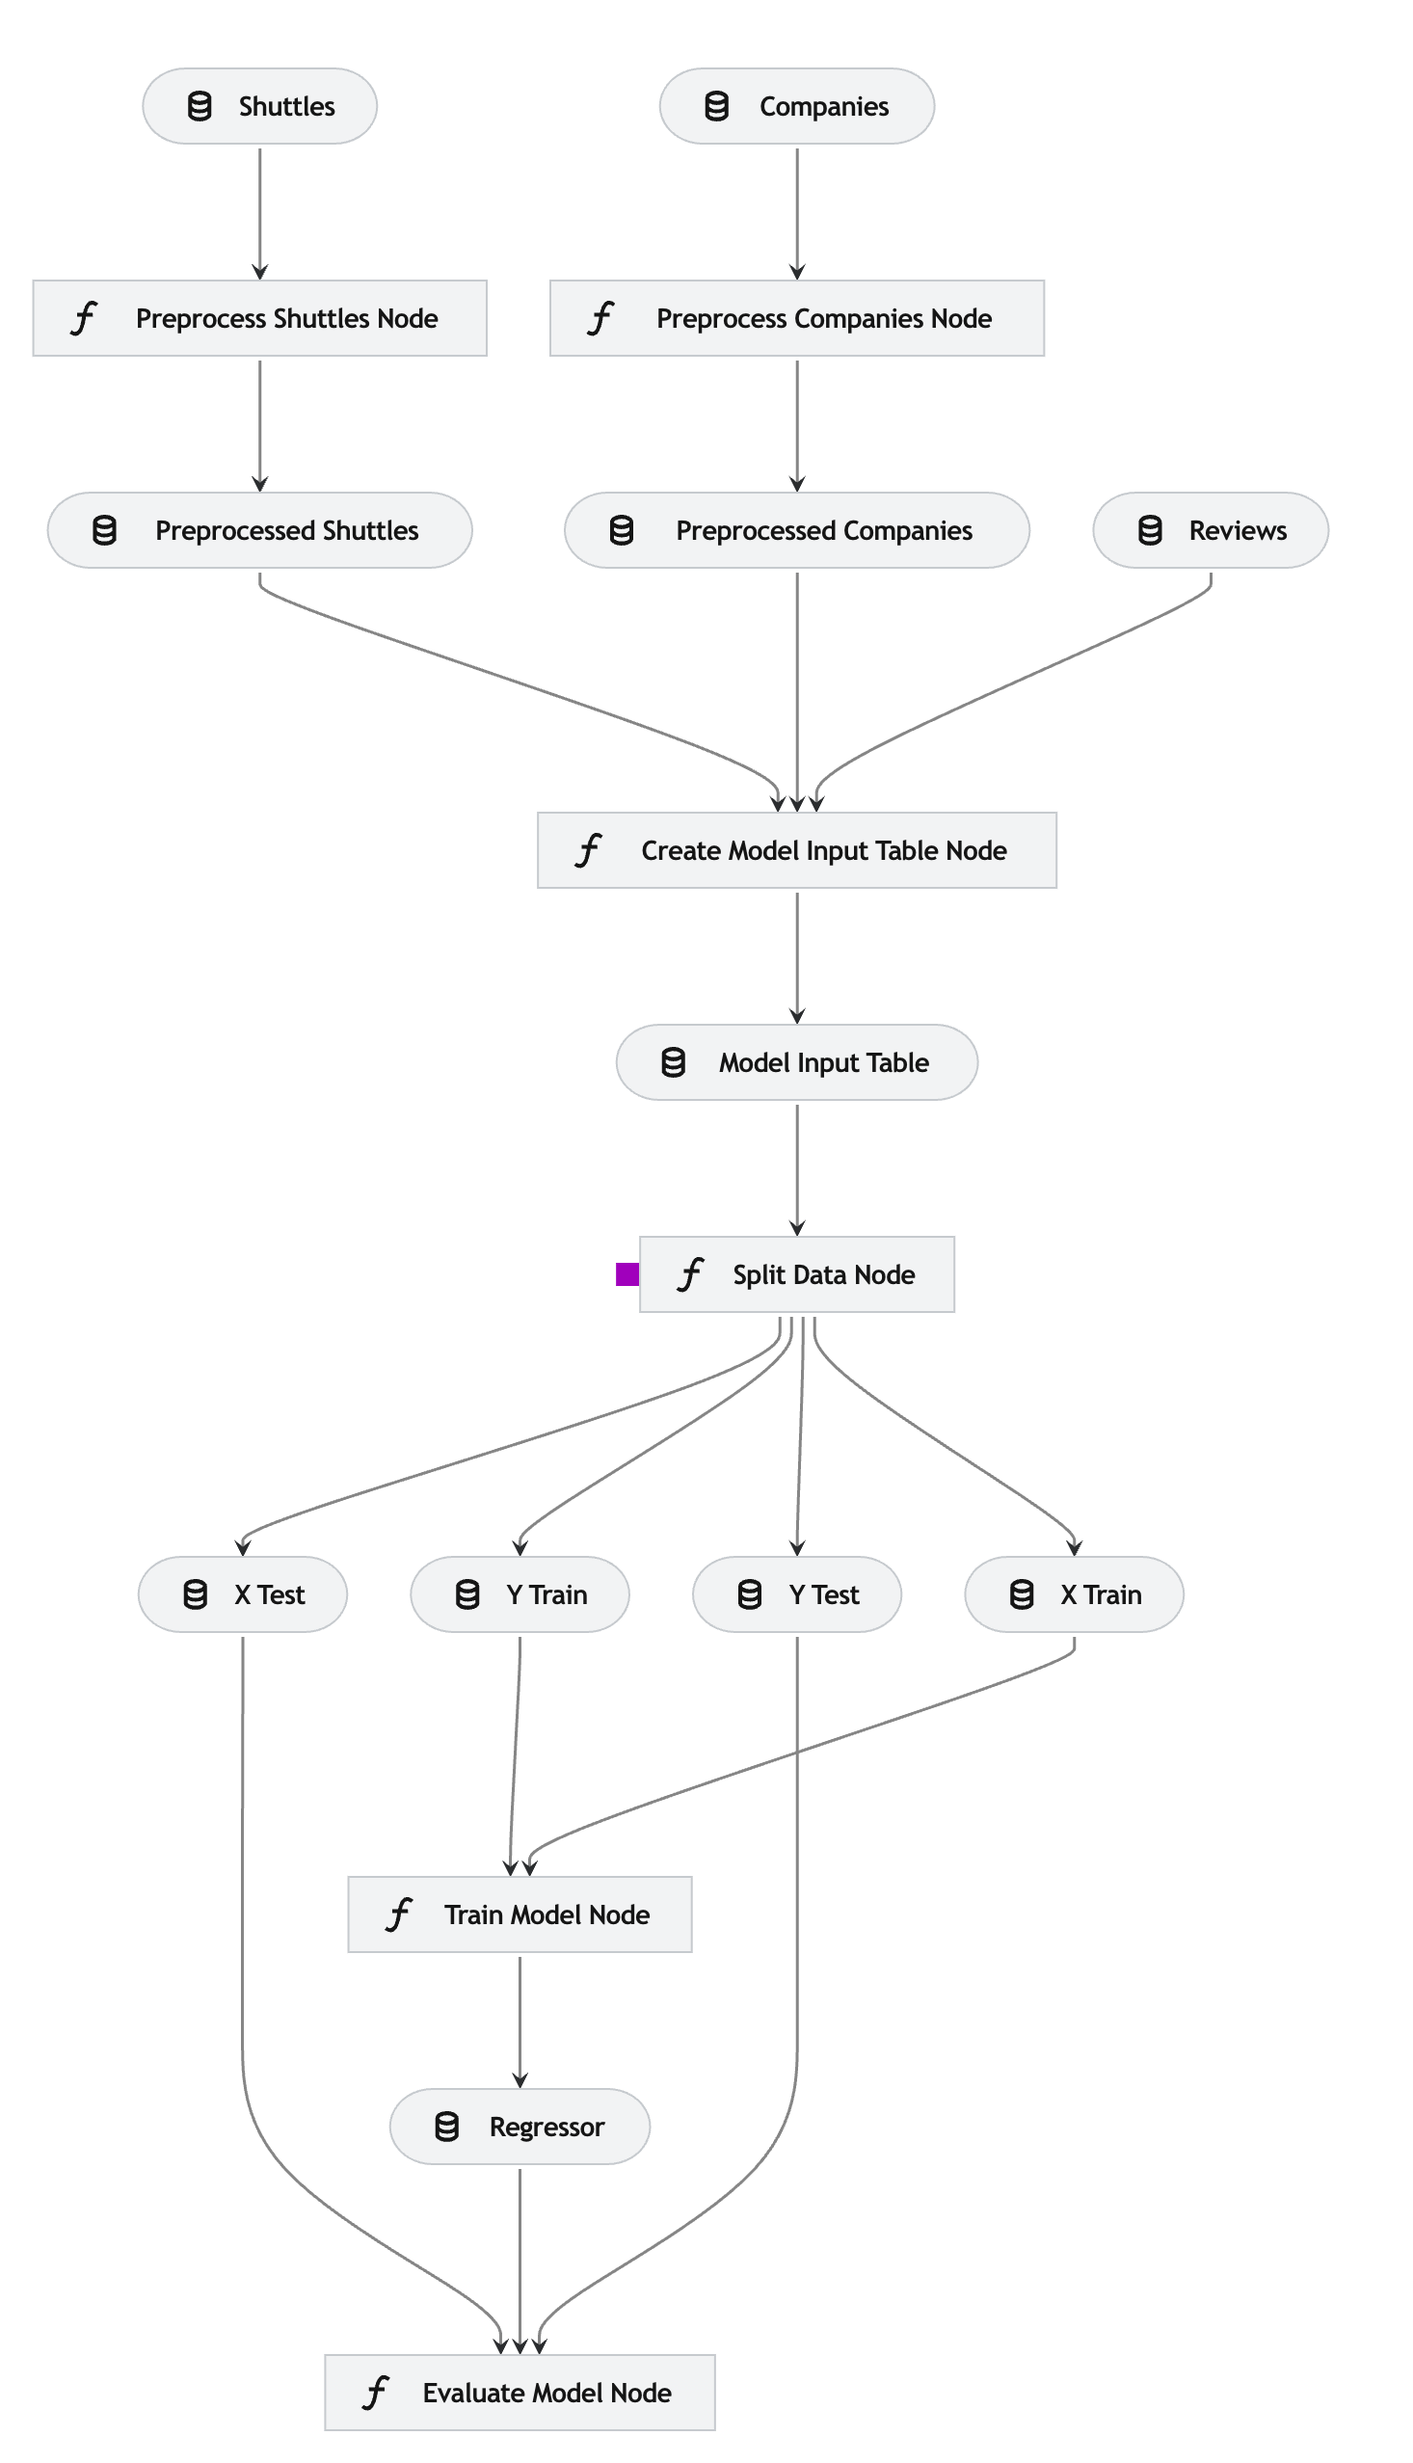
Example project
Scenario
The year is 2160 and the space tourism industry is booming.
There are thousands of space shuttle companies taking tourists to the Moon and back.
You have been able to source amenities offered in each space shuttle, customer reviews and company information.
Goal
Build a model to estimate the price of a return trip.

Slide 17
04
Modularity

Slide 18
Modularity
Breaking down a complex software system into smaller, independent modules.
Each module is responsible for a specific function or feature and operates independently.
Modules should be loosely coupled, meaning that they should not depend on each other too much.
Enhanced readability and understandability of the system
Allows for reusability
Easier collaboration
Makes it easier to test smaller chunks, which can be faster and help find bugs
Notes:
What is modularity?
a design principle that involves breaking down a complex software system into smaller, independent modules. Each module is responsible for a specific function or feature and operates independently.
Why is it good?
enhances the understandability of the system
Easier to navigate and think about the codebase
Easier collaboration
Reusability
makes it easier to test smaller chunks, which can be faster and help find bugs
Isolating issues within specific modules simplifies debugging and updating processes.
How Kedro is designed to encourage a modular project design
Using functions (from jupyter notebook cells)
A pipeline flow
- Writing modular code involves breaking down larger tasks into smaller, self-contained functions. Each function should perform a specific task and have a clear input and output. This makes it easier to test and debug individual functions, as well as reuse them in different parts of the code.
Each module typically focuses on a specific aspect of the project, such as data cleaning, feature extraction, model training, or result visualization

Slide 19


Nodes & Pipelines
What is a node?
A pure Python function that has an input and an output.
Node definition supports multiple inputs for things like table joins and multiple outputs for things like producing a train/test split.
What is a pipeline?
It is a directed acyclic graph.
A collection of nodes with defined relationships and dependencies.
Input dataset
Python function
Output dataset
+
Input dataset
Python function
Output dataset
Input dataset
Python function
Output dataset
+
Input dataset
Python function
Output dataset

Slide 20
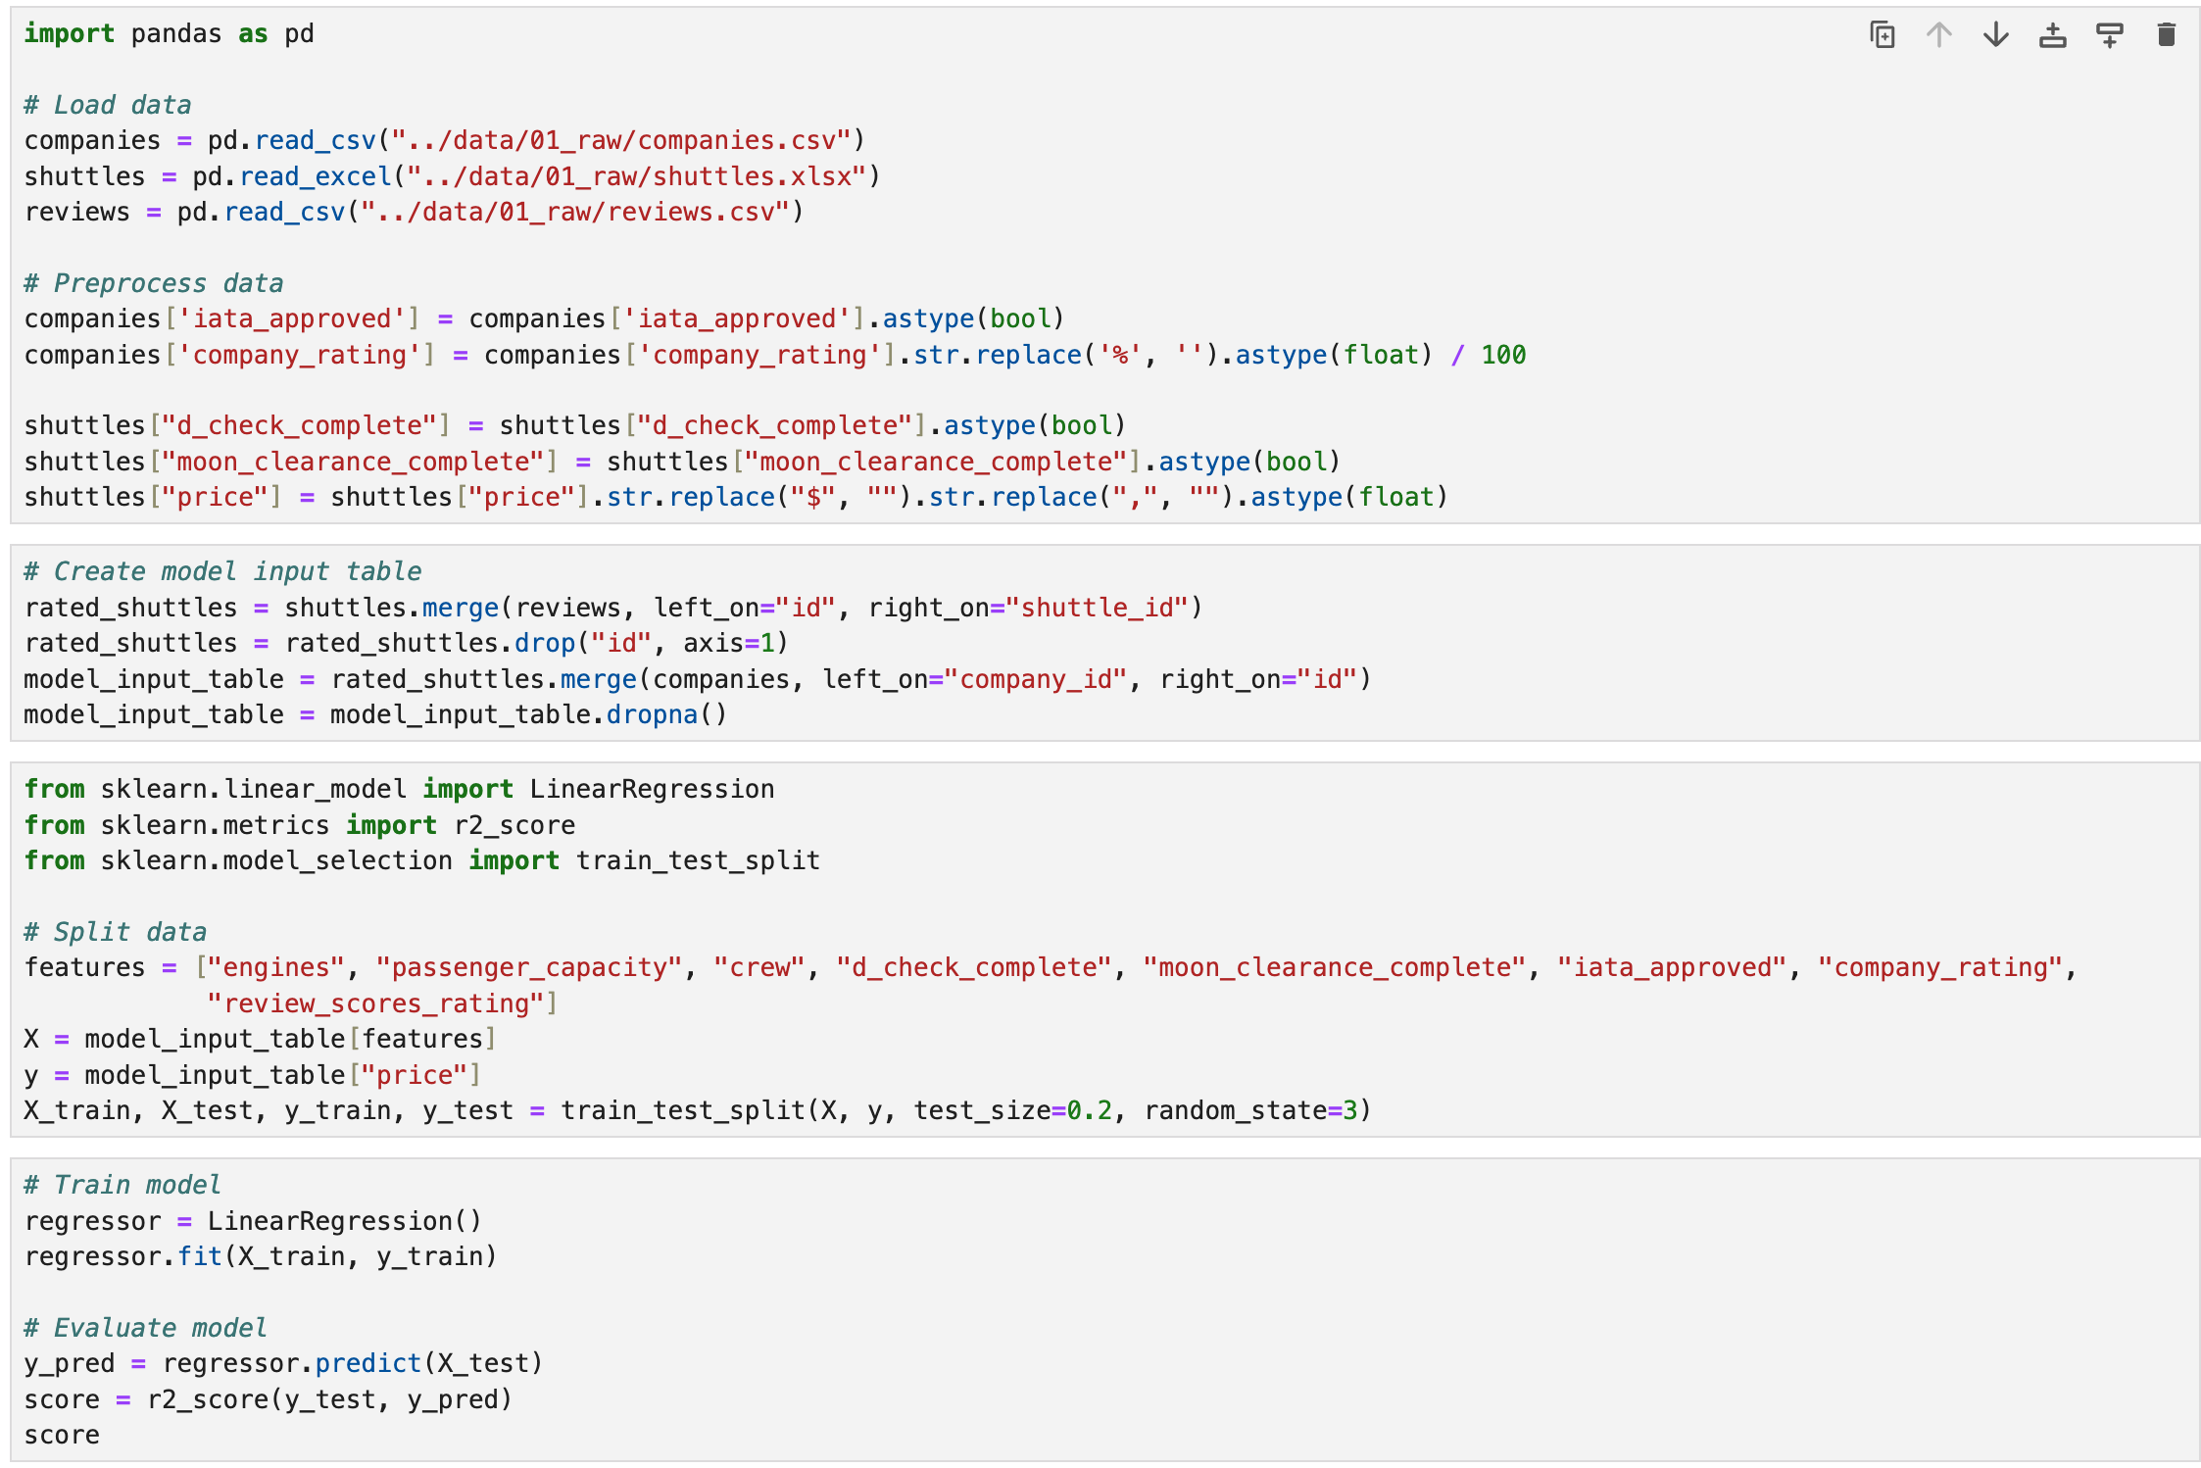
Example data science project
Before refactoring

Slide 21
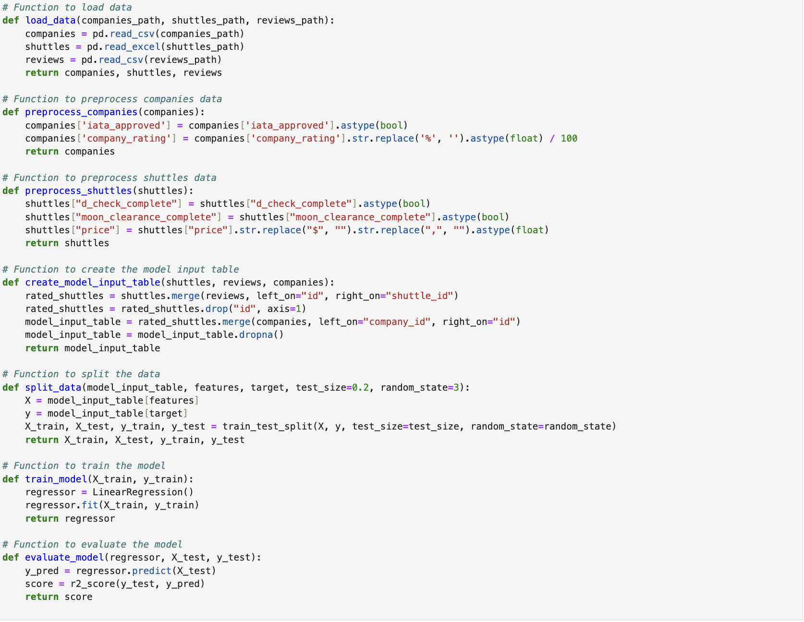
Example with modularity
Code separated into functions

Slide 22
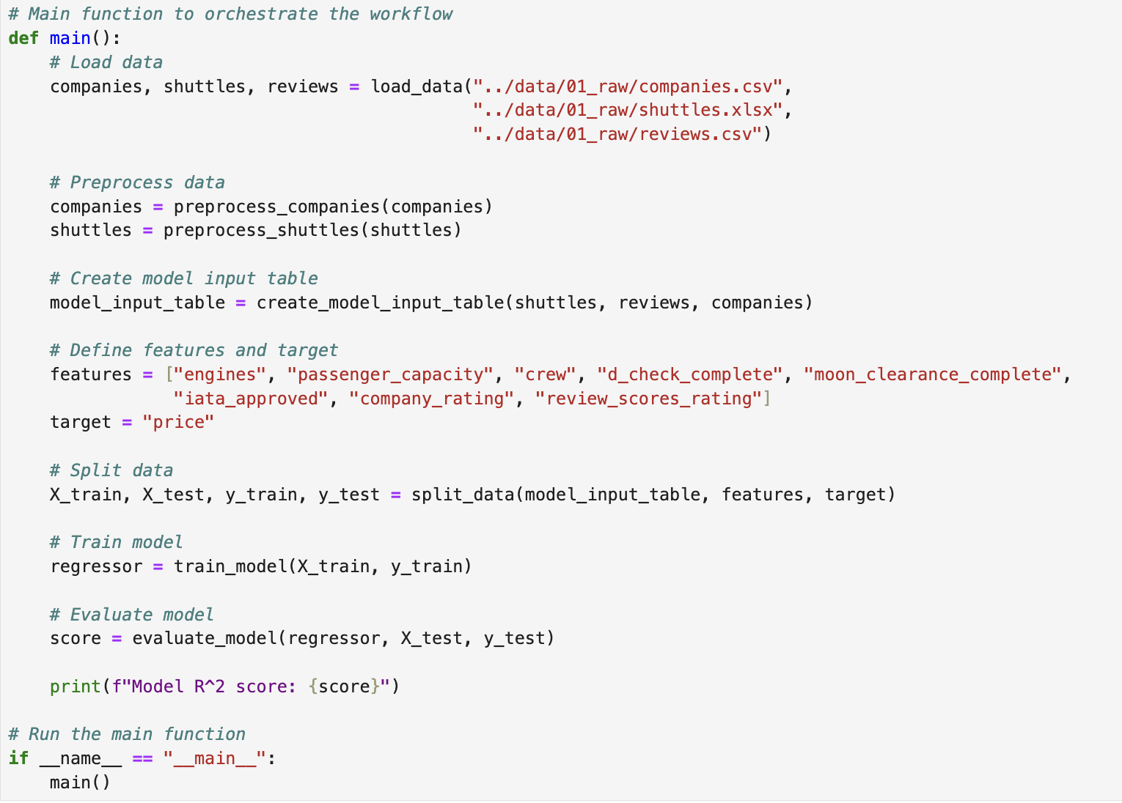
Example with modularity
Main method that calls all functions

Slide 23
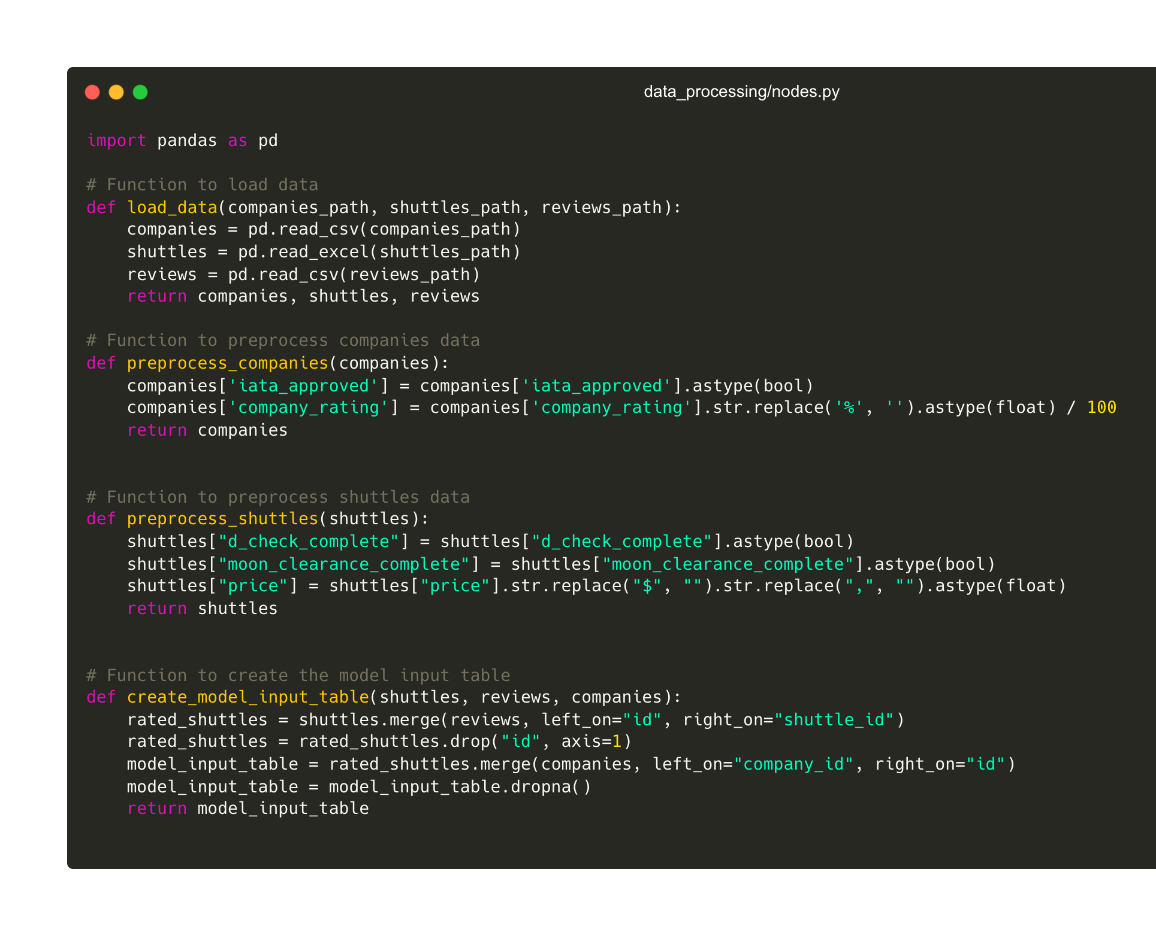
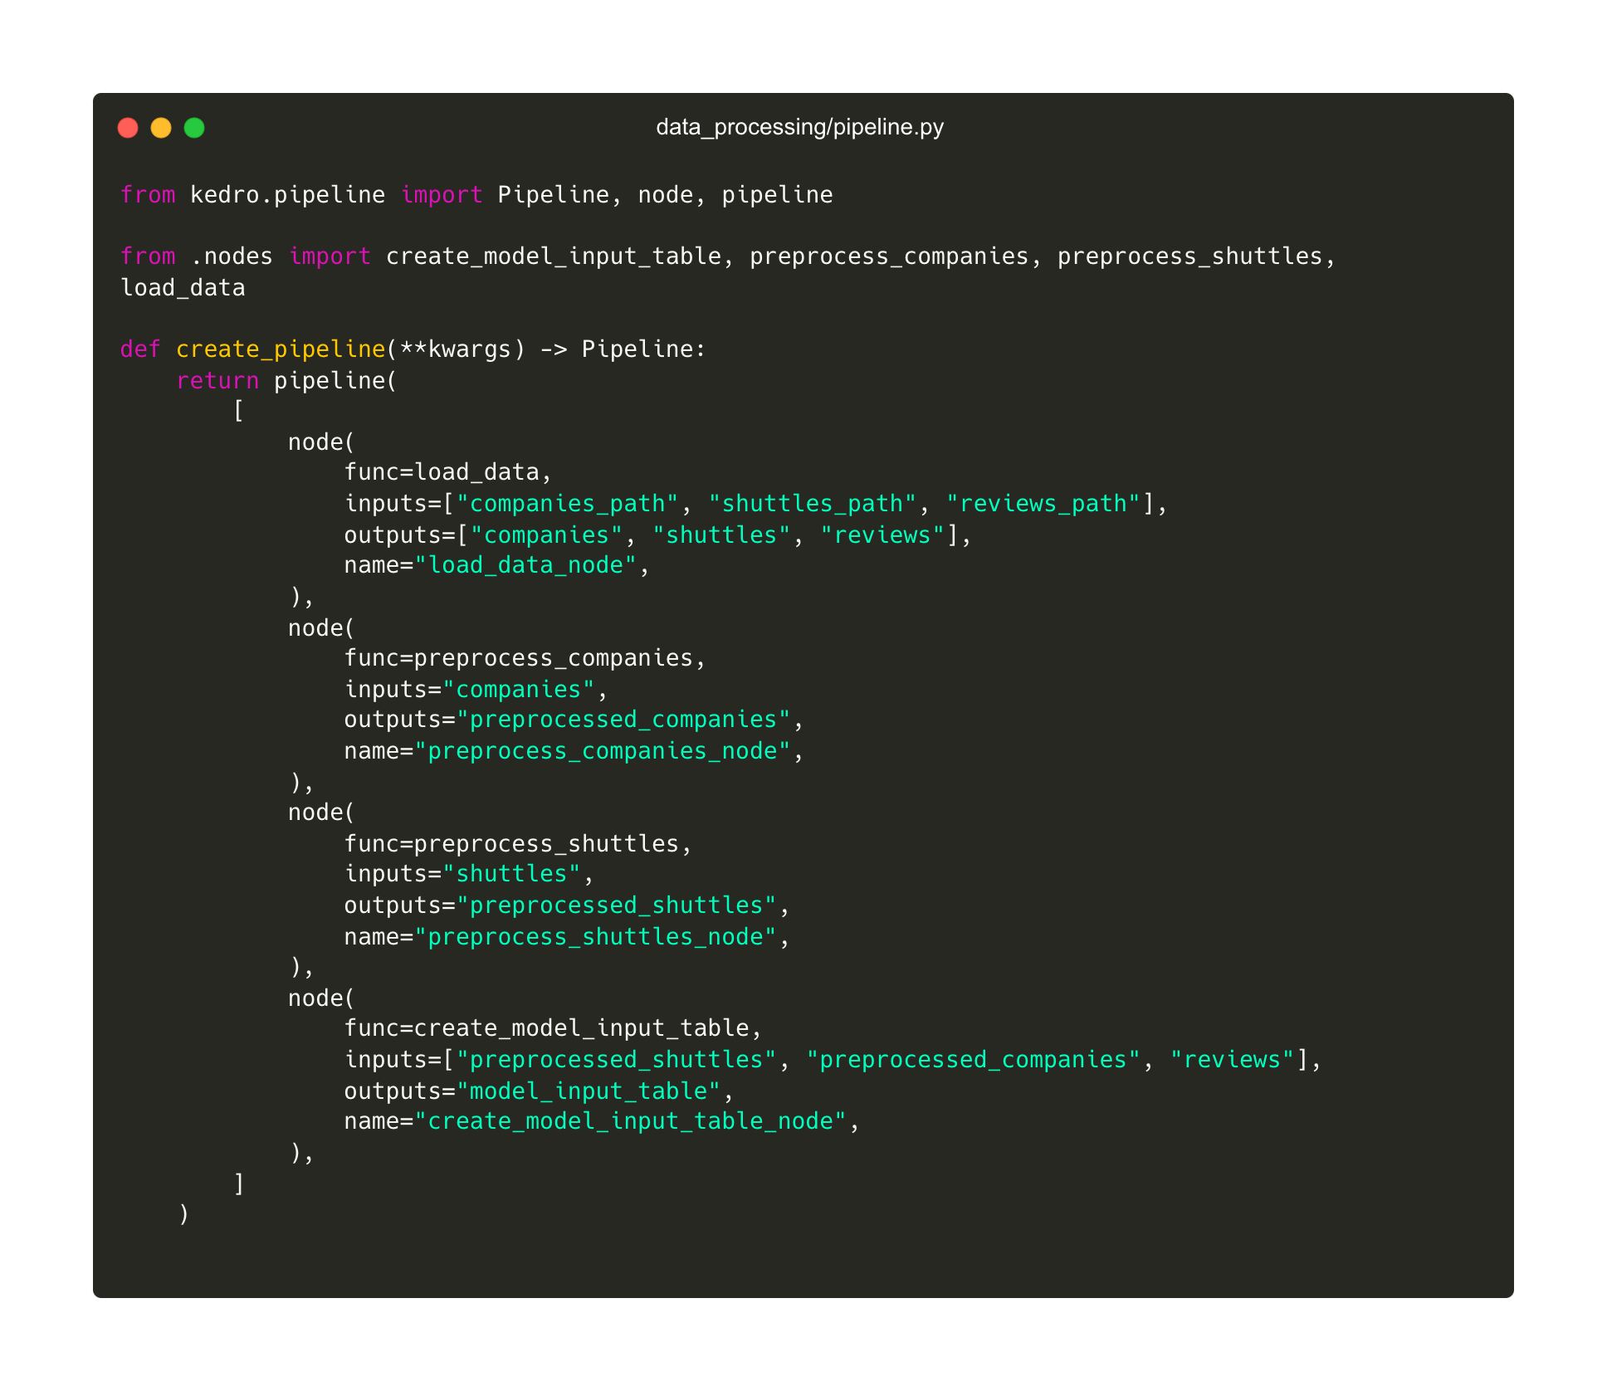
Example with modularity in Kedro
Using nodes and pipeline to structure the functions

Slide 24
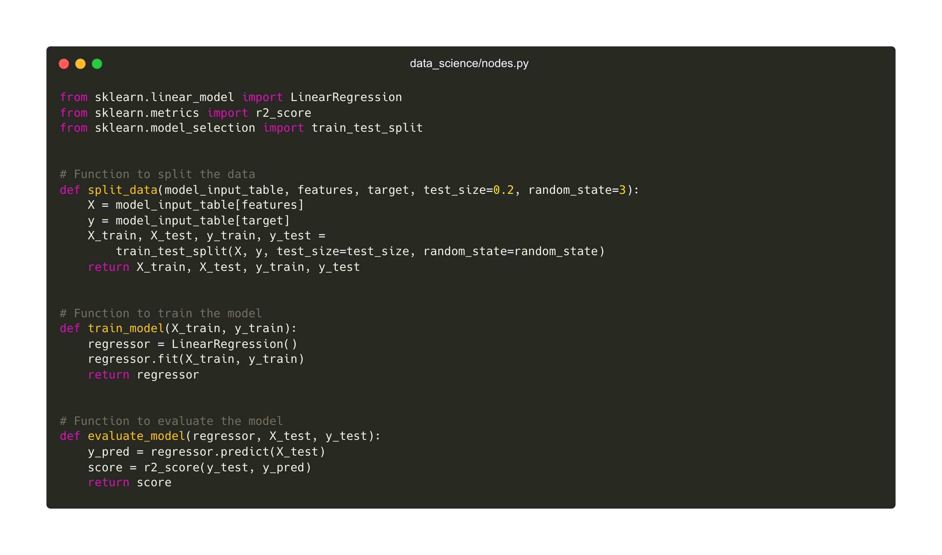
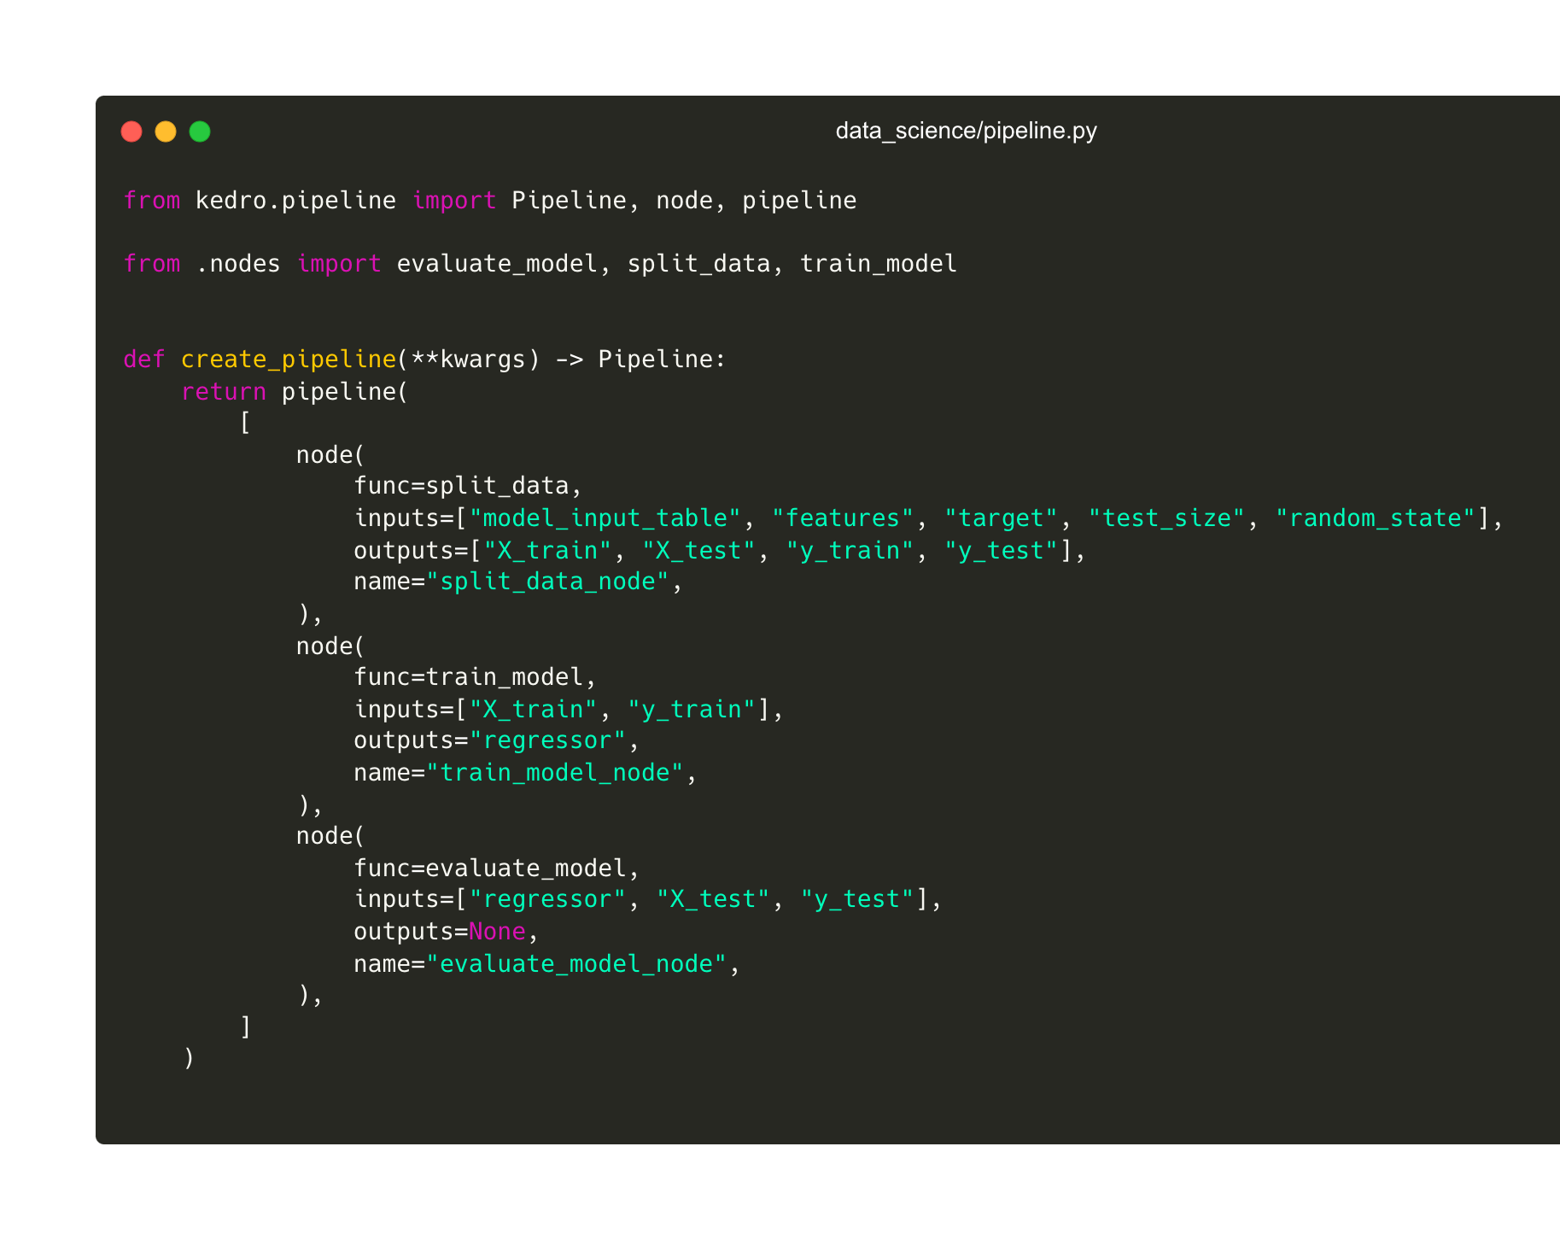
Example with modularity in Kedro
Using nodes and pipeline to structure the functions

Slide 25
05
Separation of concerns

Slide 26
Separation of concerns
Different parts of software system should be designed to address different concerns
E.g. separate user interaction layer, data access layer and business logic layer
Separation of concerns helps to improve the readability, understandability, and maintainability of software systems.
It also makes it easier to change and evolve the system over time.
Notes:
Proper separation also comes with other benefits. It's easier for people to find themselves around your project, it lessens the mental load required to dive into a targeted part of the system (don't need to wade through UI code if you are fixing business logic, etc.).
Separating the jobs of different parts of the system is even more critical - only one system should handle talking to a particular external API, etc.
Data management I/O
Model settings
Central place for credentials handling

Slide 27






Configuration
What is configuration?
“Settings” for your machine-learning code
A way to define requirements for data, logging and parameters in different environments
Helps keep credentials out of your code base
Keep all parameters in one place
What does configuration help you do?
Machine learning code that transitions from prototype to production with little effort
Makes it possible to write generalisable and reusable analytics code that does not require significant modification to be used
Parameters
Hyperparameters
Experiment
Parameters for machine learning models, such as learning rate, number of iterations and train/test split.
Hyperparameters for deep learning models, such as number of layers and number of neurons.
Experiment configuration, such as the number of trials, the random seed, and the logging level.
Location of Input Data
Credentials
Location of Output Results
Paths to files and directories, so the code knows where to find the data it needs. Also specify required columns or filters.
Connection information for databases and other data sources, such as server address and credentials.
Output settings, such as the directory for saving the results, file format, and level of verbosity.
EXPERIMENT OR MODEL
DATA ACCESS

Slide 28
Data catalog
What is the Catalog?
Manages the loading and saving of your data
Available as a code or YAML API
Versioning is available for file-based systems every time the pipeline runs
What does the Catalog help you do?
Never write a single line of code that would read or write to a file, database or storage system
Makes it possible to write generalisable and reusable analytics code that does not require significant modification to be used
Access data without leaking credentials

Slide 29
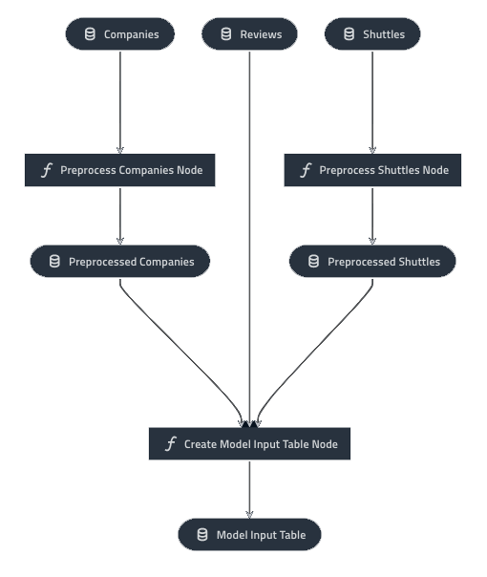
Kedro connects datasets and nodes through pipelines
Nodes are normal Python functions and datasets are declared in YAML
# catalog.yml companies: type: pandas.CSVDataset filepath: data/01_raw/companies.csv shuttles: type: pandas.ExcelDataset filepath: data/01_raw/shuttles.xlsx reviews: type: pandas.CSVDataset filepath: data/01_raw/reviews.csv model_input_table: type: pandas.ParquetDataset filepath: s3://my_bucket/model_input_table.pq versioned: true
# pipelines.py def create_pipeline(**kwargs): return pipeline([ node( func=preprocess_companies, inputs="companies", outputs="preprocessed_companies", ), node( func=preprocess_shuttles, inputs="shuttles", outputs="preprocessed_shuttles", ), node( func=create_model_input_table, inputs=[ "preprocessed_shuttles", "preprocessed_companies", "reviews", ], outputs="model_input_table", ), ])

Slide 30
Example data science project
Before refactoring
Notes:
We can separate out the data loading/saving operations
Move hard-coded values for filepaths and parameters to a central configuration

Slide 31
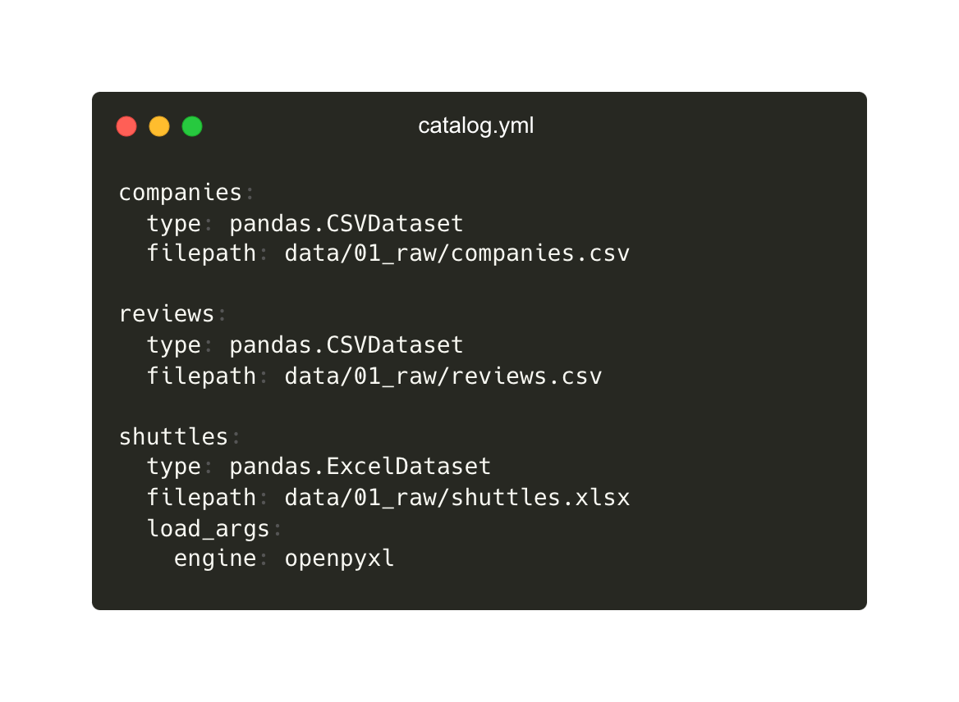
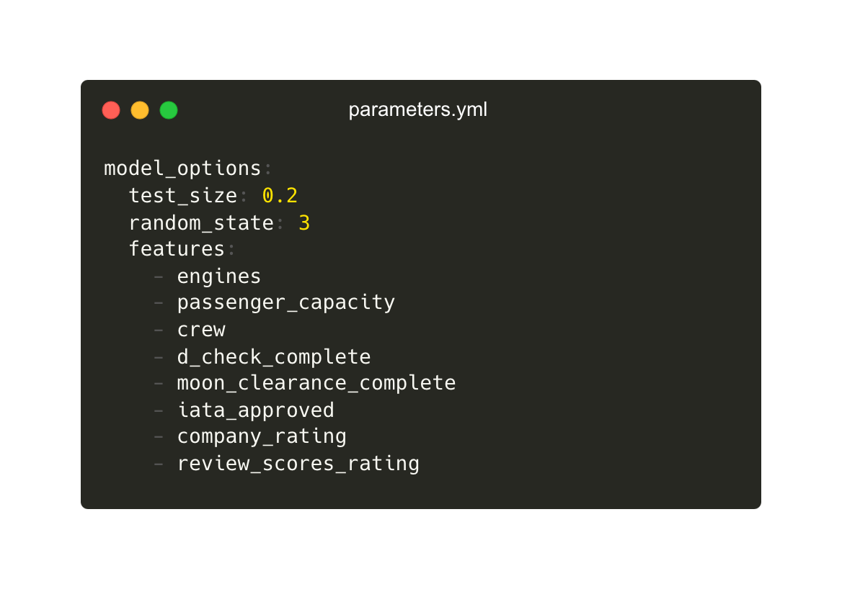
Separate data I/O and configuration
Put I/O information and parameters in configuration

Slide 32
Data I/O handled by the DataCatalog
No longer need code to read or save data

Slide 33
Data I/O handled by the DataCatalog
No longer need code to read or save data

Slide 34
“Settings” put into configuration
Use parameters from config

Slide 35
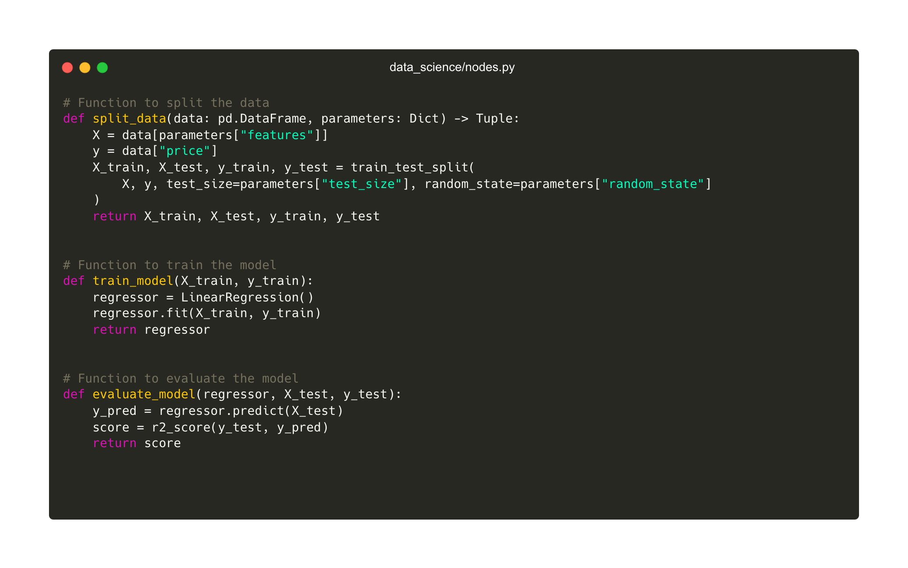
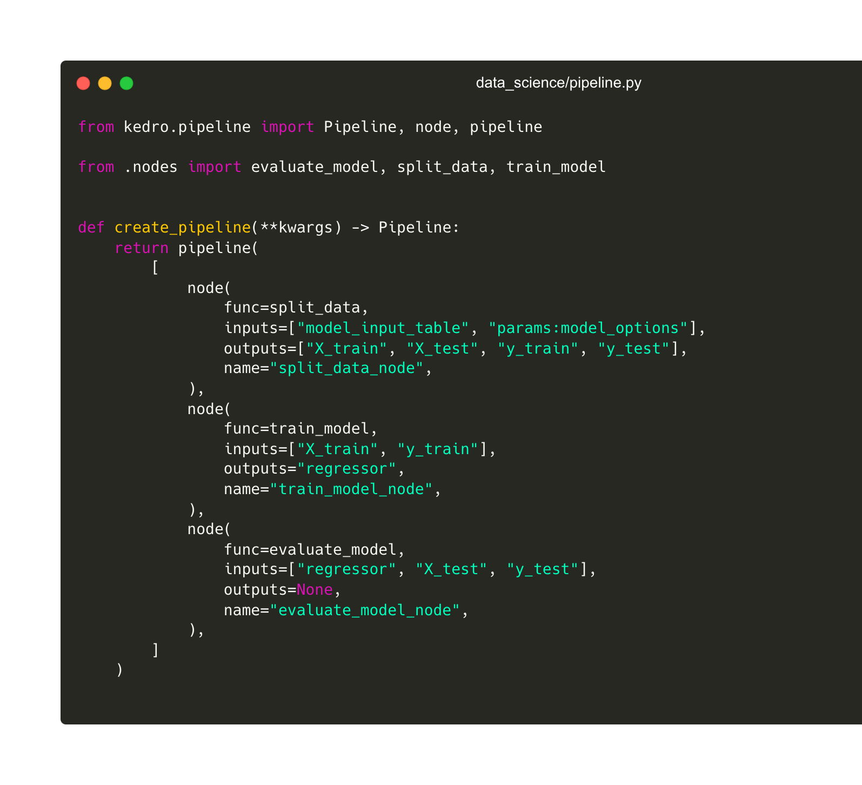
“Settings” put into configuration
Use parameters from config

Slide 36
06
Maintainability

Slide 37
Maintainability
A measure of how easy it is to understand, modify, and improve software.
Testability: verifies that your code meets different requirements (functional, business, performance, reliability, etc..)
Readability: linted, formatted and documented code
Findability: structure and organisation of code
Notes:
Testing verifies that your code meets different requirements (functional, business, performance, reliability, security, usability)
If the software isn’t systematically tested, unintended behaviour won’t be spotted easily and finding the cause might not be trivial
- Modular code is easier to test
- Testing structure in template
- Continuous integration

Slide 38

Project template
What is the project template?
Standard and customisable project structure
Built-in support for Python logging, Pytest for unit tests and Sphinx for documentation
What does the project template help you do?
Establish standardisation across your organisation
You spend less time digging around in previous projects for useful code
Makes it easier for collaborators to work with you
Configuration
Notebooks
Data
Source code
Tests
Project Documentation

Slide 39
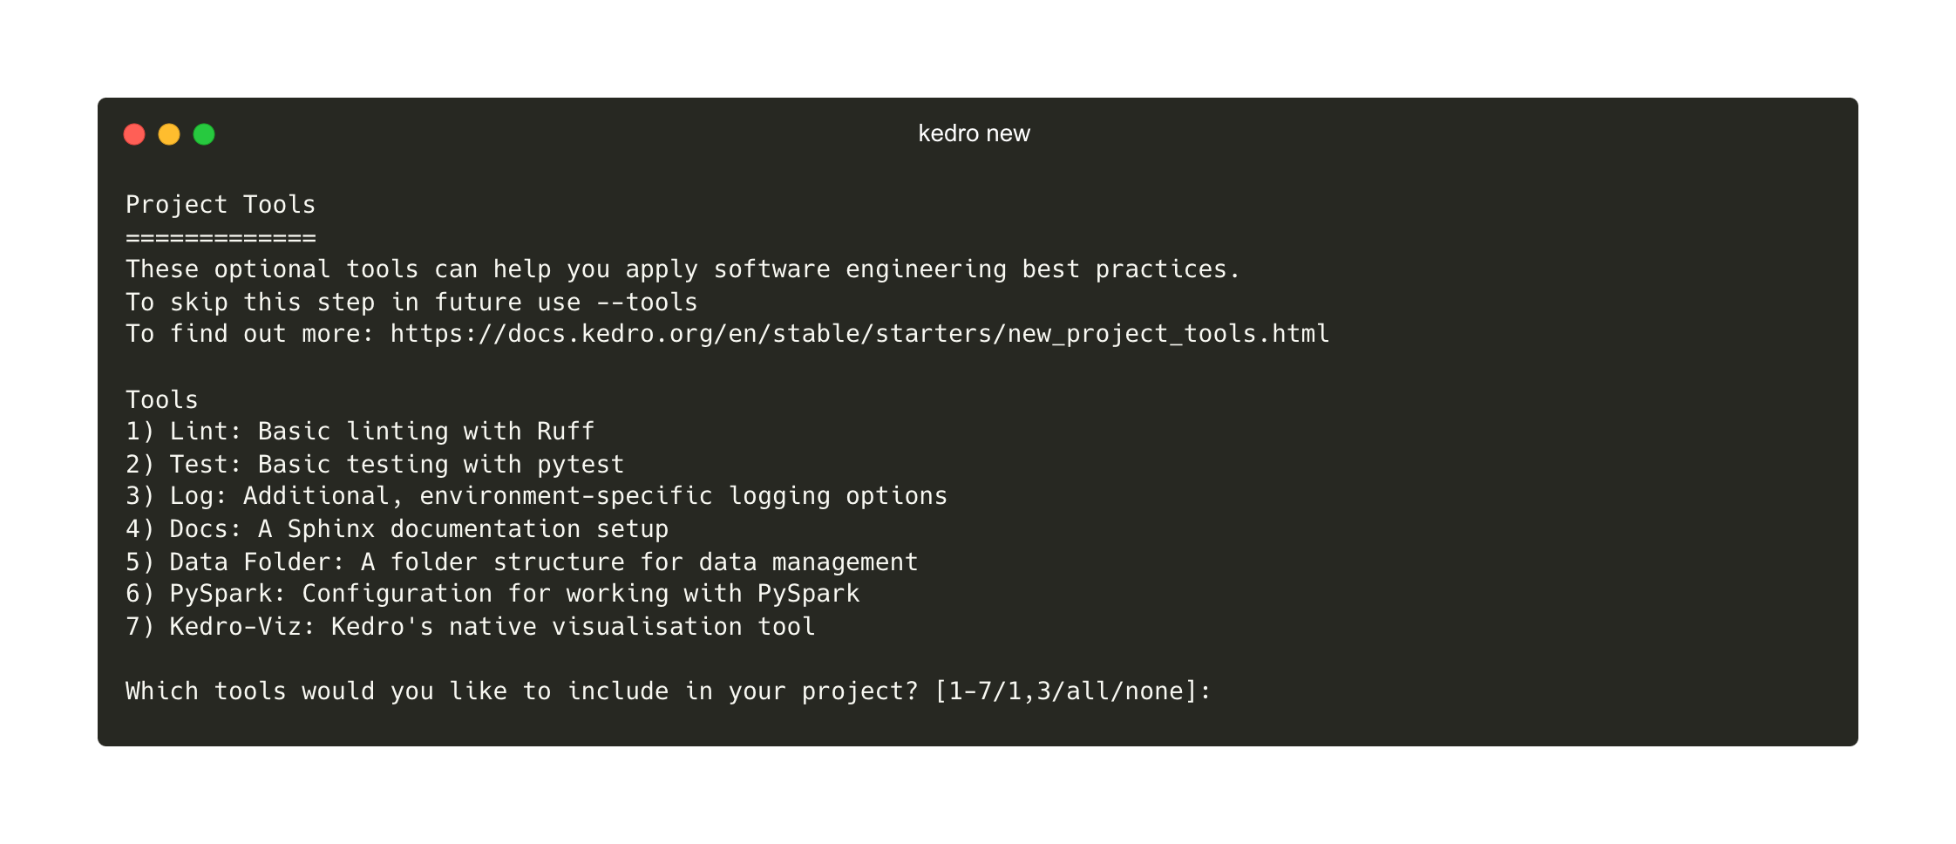
Project creation options
Include linting, testing, logging and documentation setup

Slide 40
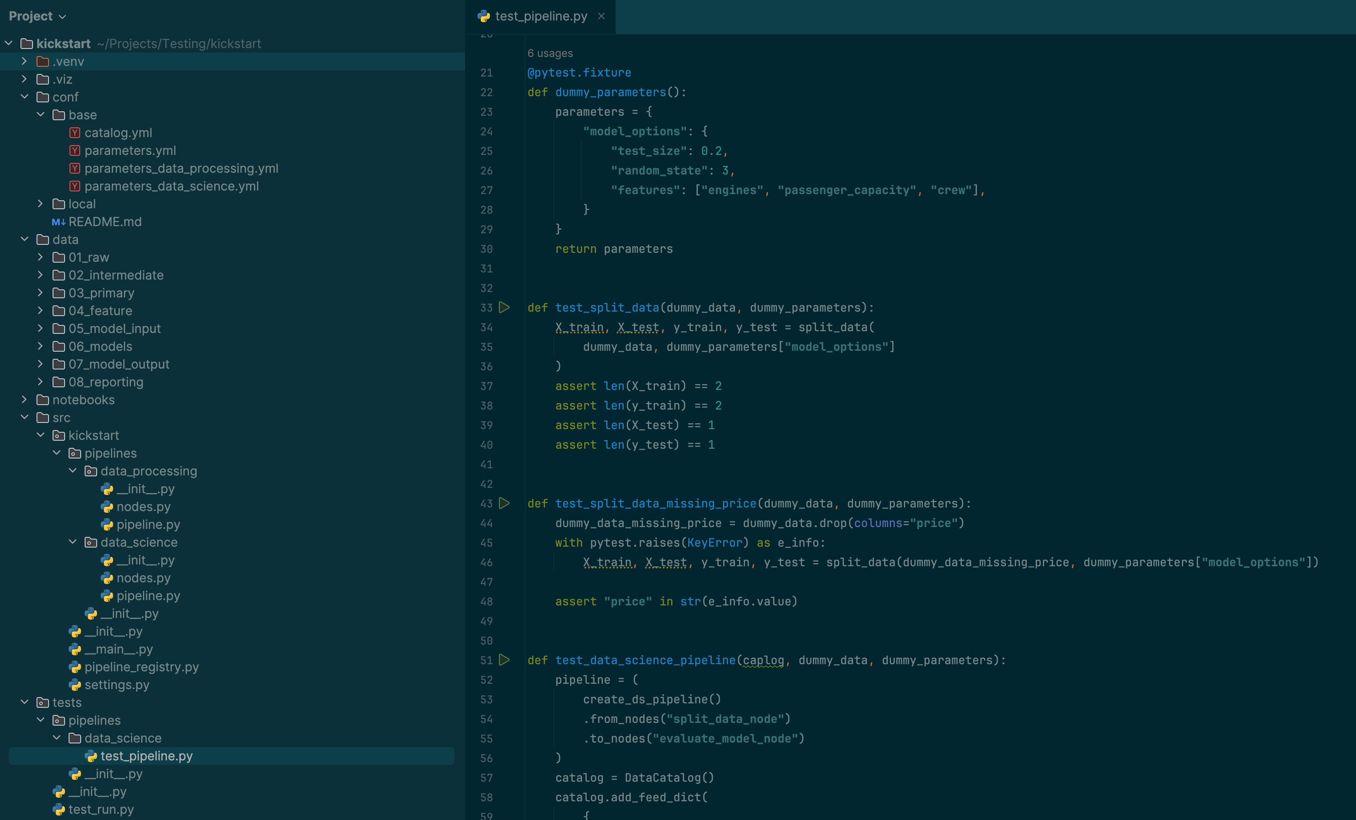
Example Kedro project structure
Including test setup & examples

Slide 41
Summary
Software Engineering principles can elevate the quality and usability of your data science projects, even when experimental
Kedro makes it easy to embed modularity, separation of concerns and maintainability
It’s possible to establish and embed best practices without any tools

Slide 42
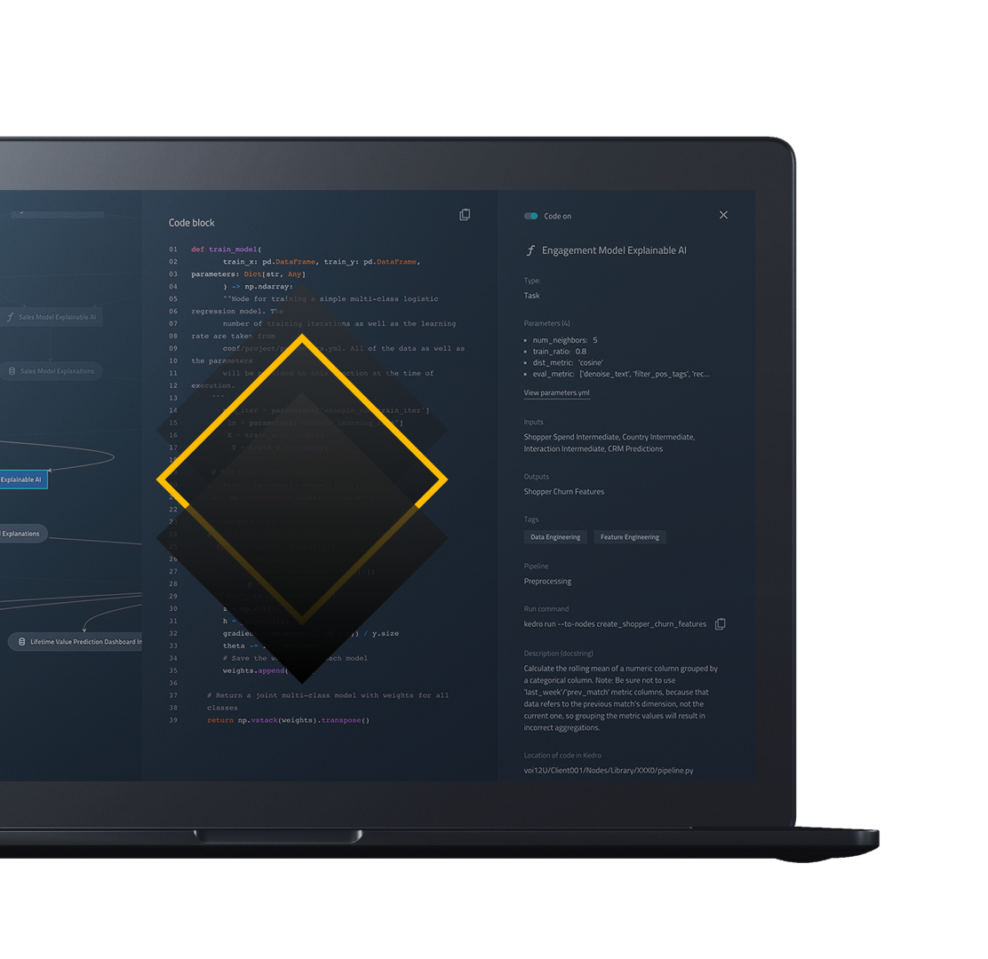


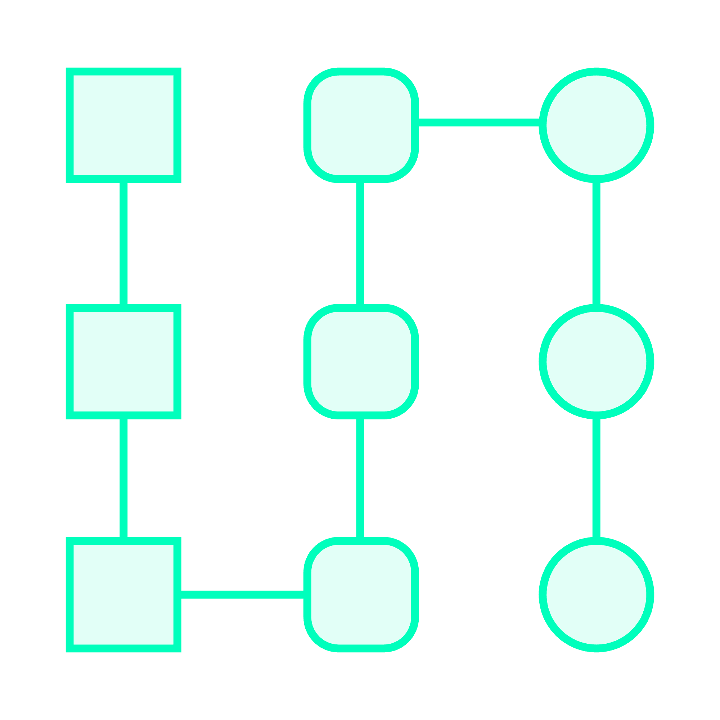


Kedro Resources
There are many resources to get started using Kedro; here is a list of resources you can access.
Convert existing work into a Kedro project We support workflows that take you from Jupyter notebooks and glue code scripts into a Kedro project. blog.kedro.org
View demo Interact with pipeline visualisation and experiment tracking with Kedro-Viz. demo.kedro.org
Learn Kedro Walk through our spaceflights tutorial and get up to speed on beginner-to-intermediate functionality. docs.kedro.org
Join the community Join a friendly and growing community of Kedroids waiting for your questions. slack.kedro.org

Slide 43
Q&A

Slide 44
Thank you!

